Slide 1
Wytrzymałość mechaniczna złoża biomasy sypkiej wyznaczana w testerze łopatkowym
Mateusz Stasiak, Marek Molenda
Institute of Agrophysics, Polish Academy of Sciences, Doświadczalna 4, 20-290 Lublin, Poland, mstasiak@ipan.lublin.pl
Project PBS3/A8/31/2015 financed by The National Centre for Research and Development
XXV JKN „Postęp Naukowo-Techniczny i Organizacyjny w Rolnictwie”; Zakopane 2018

Slide 2
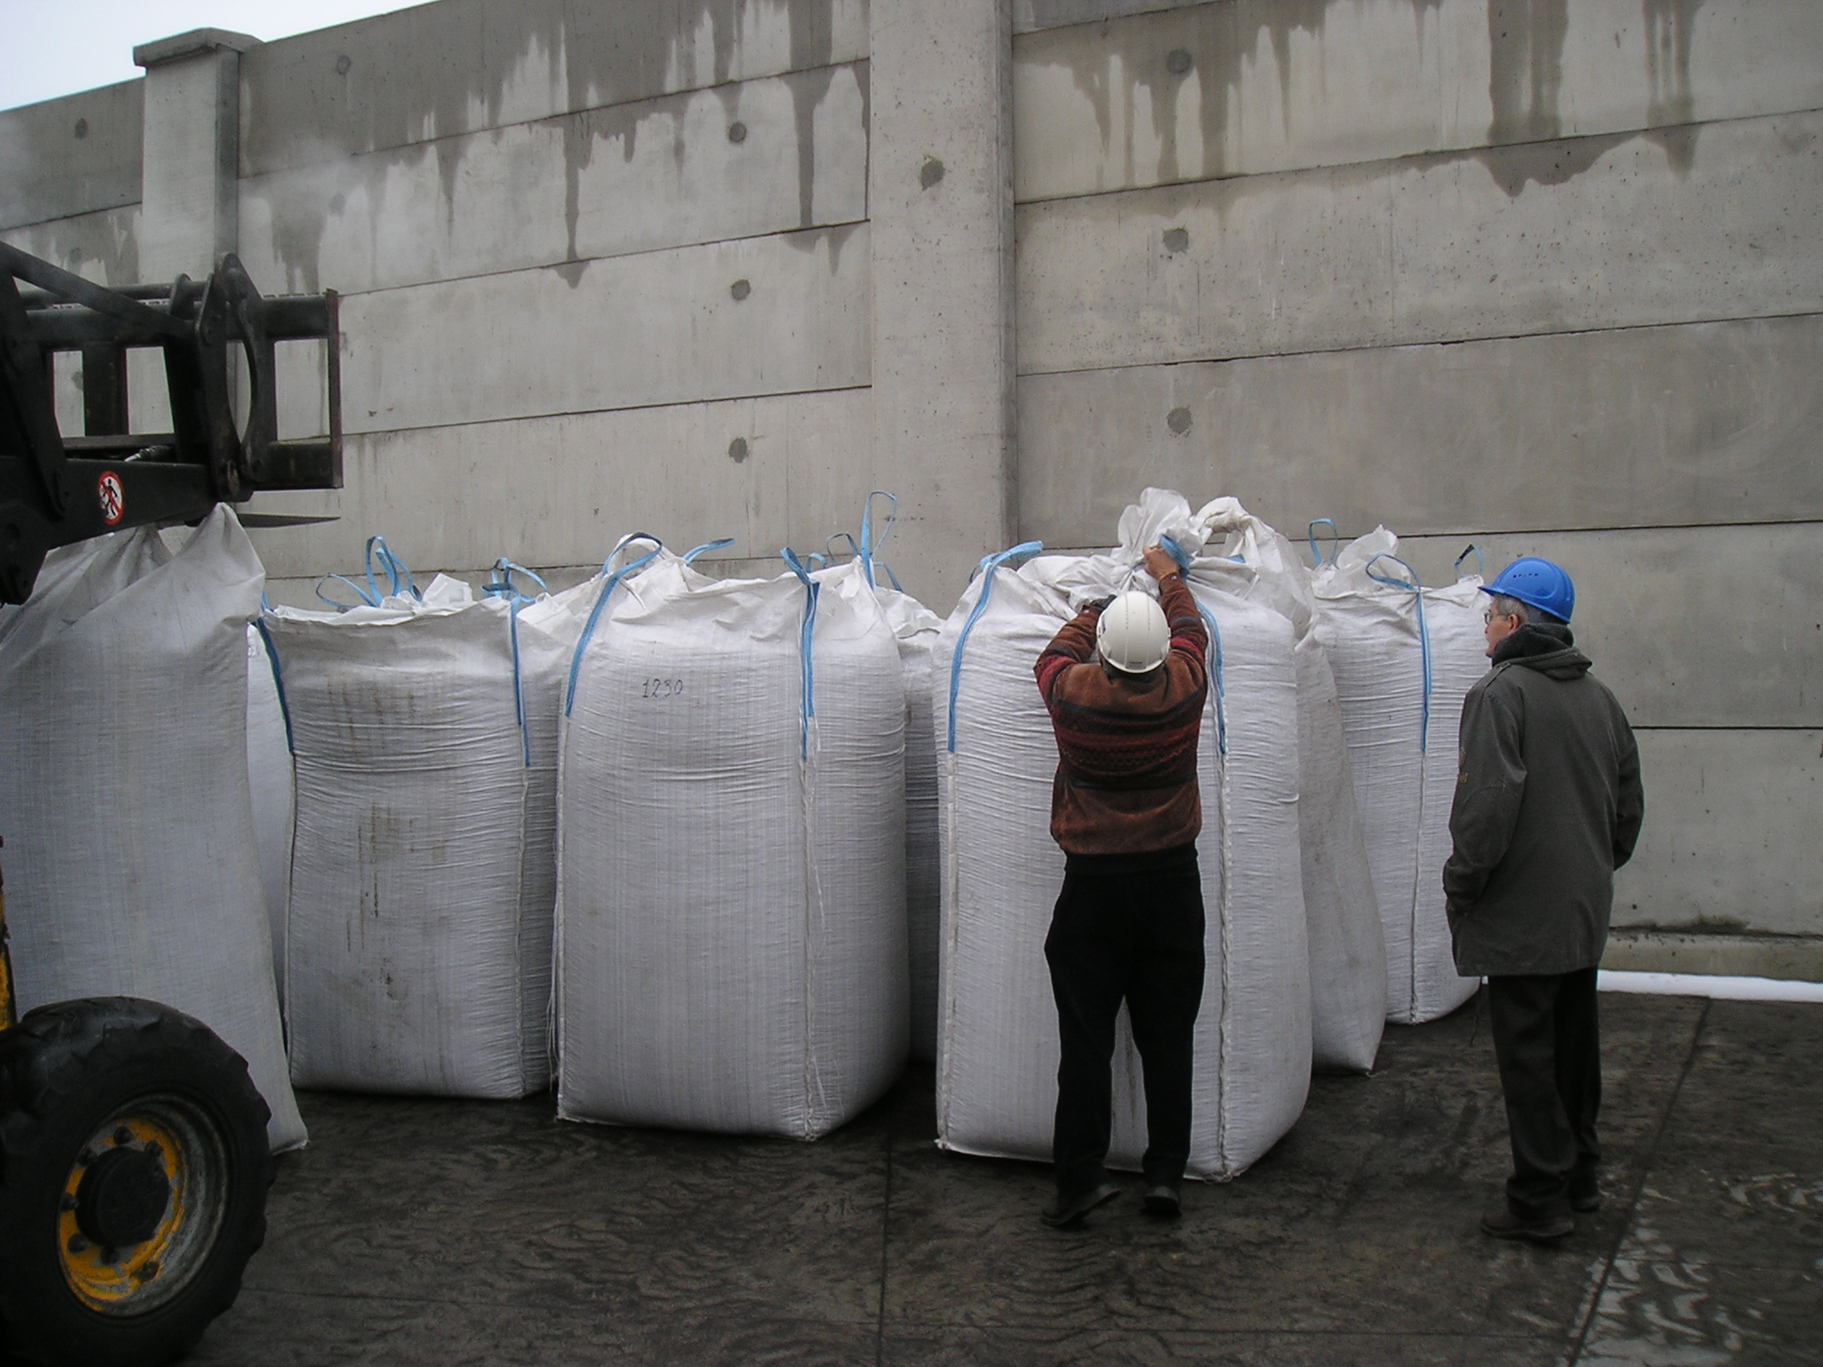
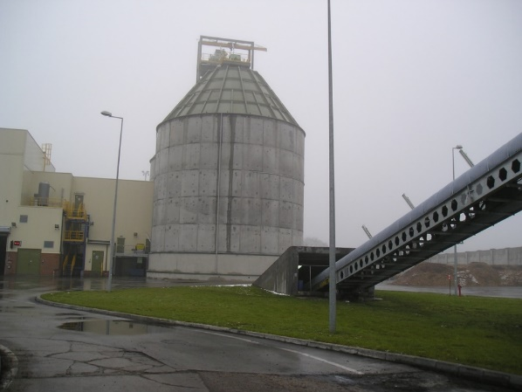
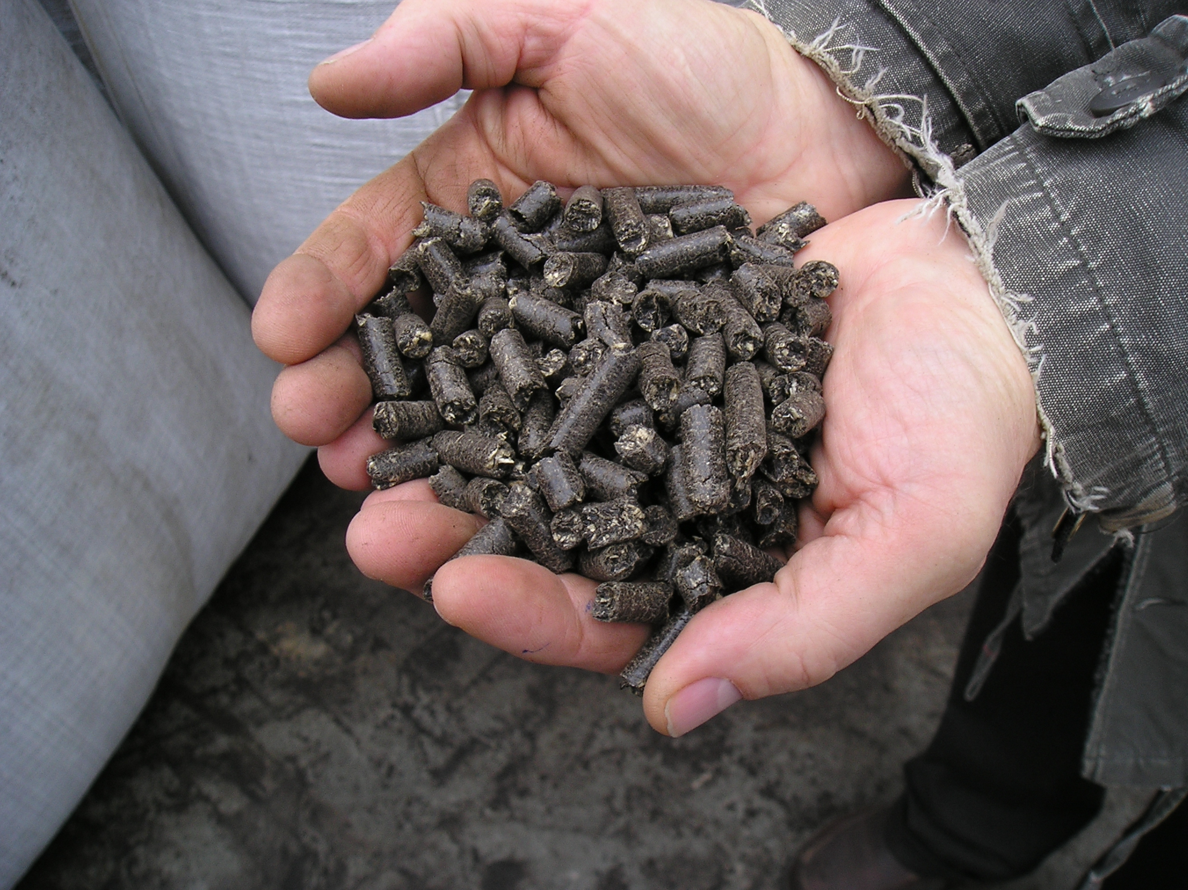
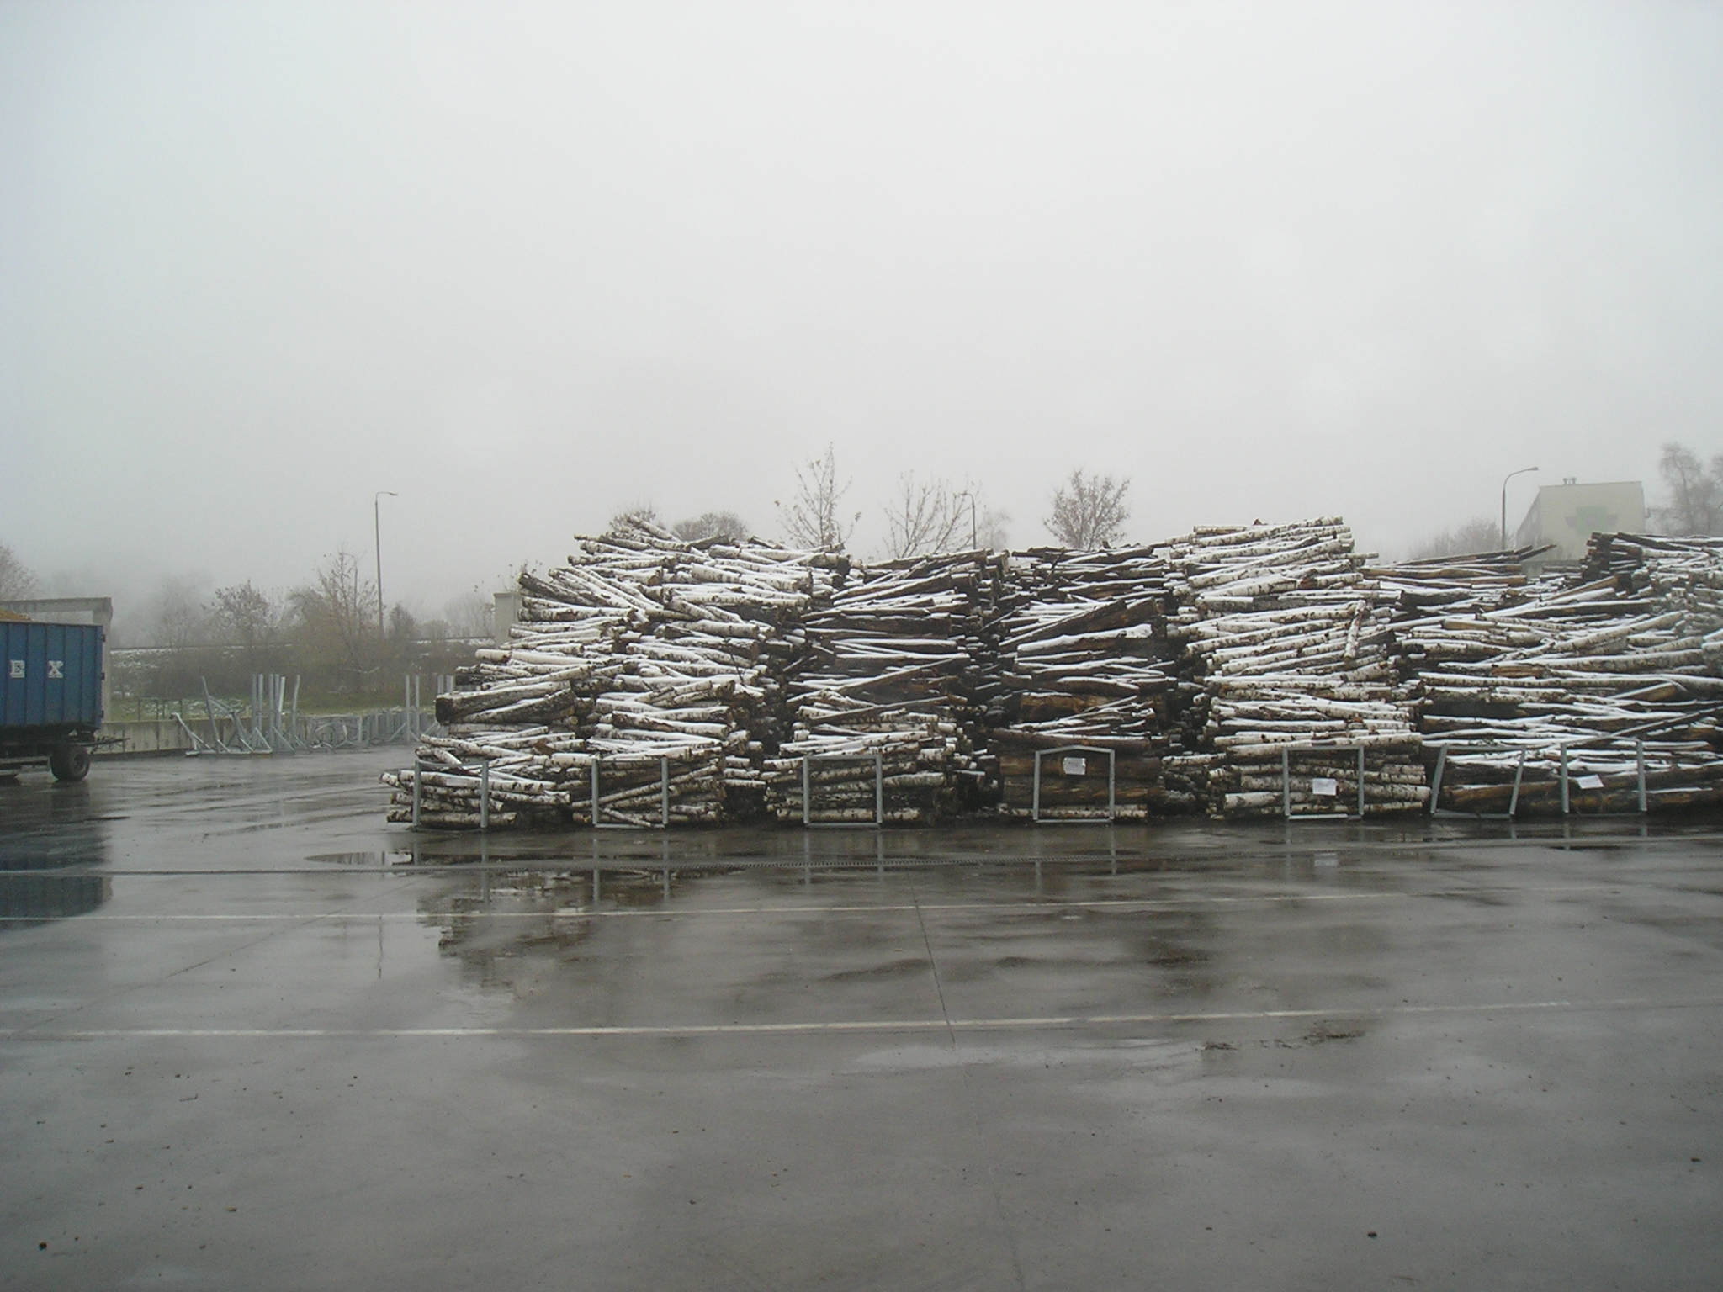
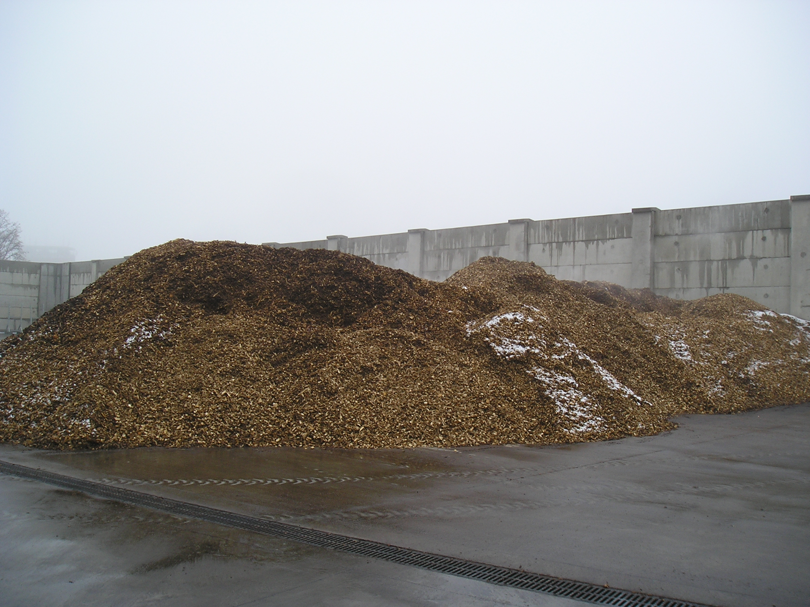
BACKGROUND
XXV JKN „Postęp Naukowo-Techniczny i Organizacyjny w Rolnictwie”; Zakopane 2018

Slide 3
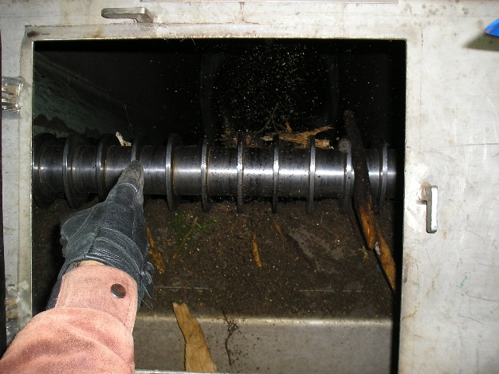
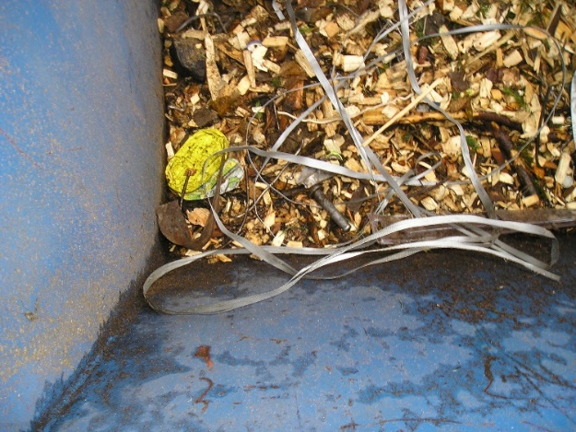
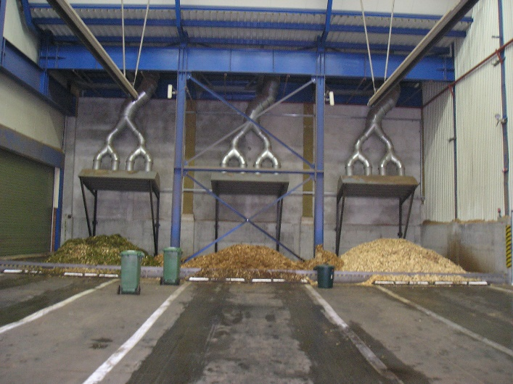
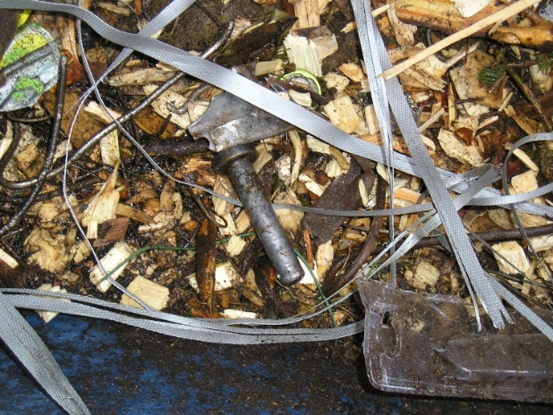
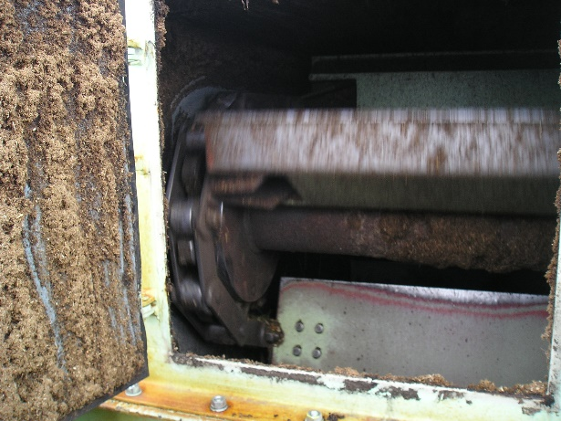
BACKGROUND
Woodchips 70%
Snow, water !!!!
XXV JKN „Postęp Naukowo-Techniczny i Organizacyjny w Rolnictwie”; Zakopane 2018

Slide 4
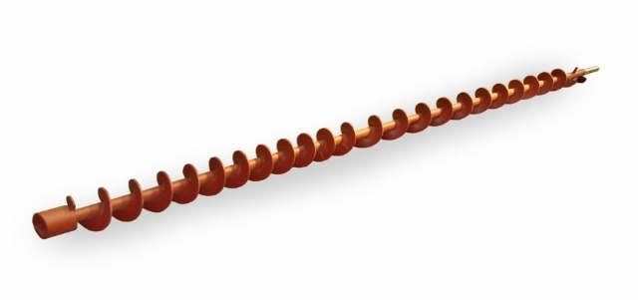
BACKGROUND
TERMALL Sp. z o.o.
INSTITUTE of AGROPHYSICS,
POLISH ACADEMY of SCIENCES
Designer and Users needs:
Rapid determination of
Moisture content
Density
Storage problems
Problems with emptying
Biomass Valuation
Hamech.pl
XXV JKN „Postęp Naukowo-Techniczny i Organizacyjny w Rolnictwie”; Zakopane 2018

Slide 5
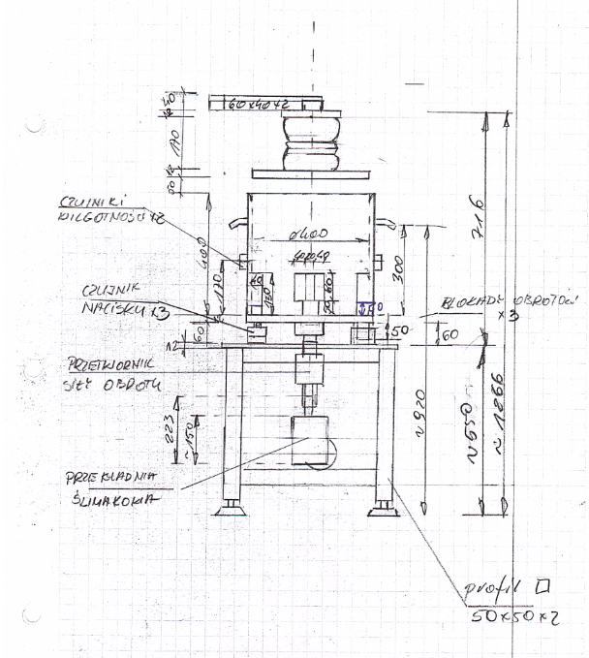
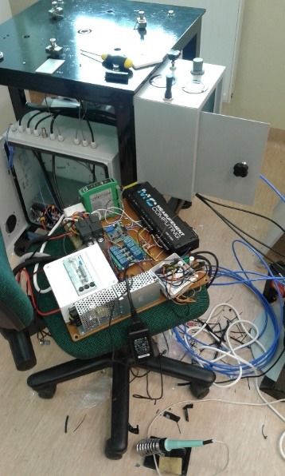
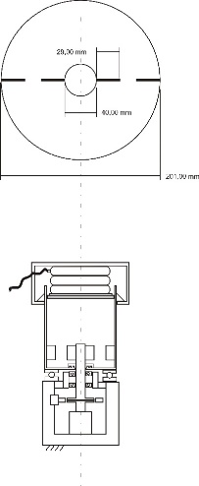
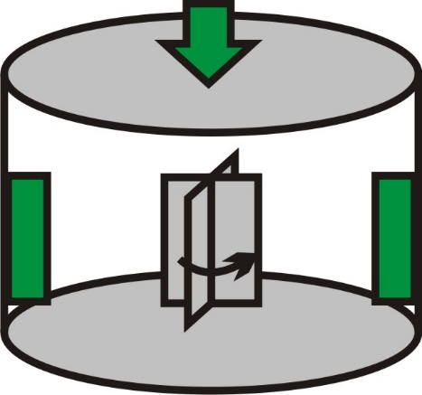
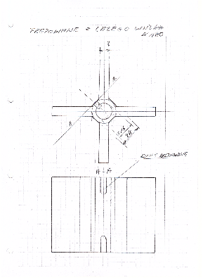
VANE TESTER
XXV JKN „Postęp Naukowo-Techniczny i Organizacyjny w Rolnictwie”; Zakopane 2018

Slide 6
MEASURING DEVICE
XXV JKN „Postęp Naukowo-Techniczny i Organizacyjny w Rolnictwie”; Zakopane 2018

Slide 7
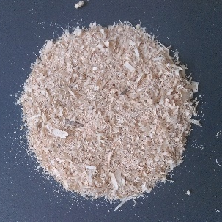
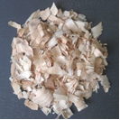
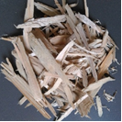
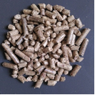
EXPERIMENTS
210 mm in diameter direct shear tester (Jenike box) and standard ring shear tester RST-01.
The tests in Jenike tester followed Eurocode 1 (2006) procedure for consolidation reference stresses σ_{r} of 15 and 30 kPa and speed of shearing V of 0.17 mm·s⁻¹.
Ring shear testing was conducted using a Schulze annular shear cell of 195 mm outer diameter. Tests were performed for 10 and 20 kPa pre-shear.
Tests in Vane Tester were conducted under 4 levels of consolidation pressure
5, 10, 20 and 30 kPa,
for 4 rotation rates 3, 6, 9 and 13 rpm.
Moisture content 10% - 60%
Materials
Sawdust
Shavings I
Shavings II
Pellet
XXV JKN „Postęp Naukowo-Techniczny i Organizacyjny w Rolnictwie”; Zakopane 2018

Slide 8
RESULTS
Typical experimental results obtained for pine sawdust and pellet in ring shear tester.
Typical experimental results obtained for pine sawdust and pellet in Jenike shear tester.
XXV JKN „Postęp Naukowo-Techniczny i Organizacyjny w Rolnictwie”; Zakopane 2018

Slide 9
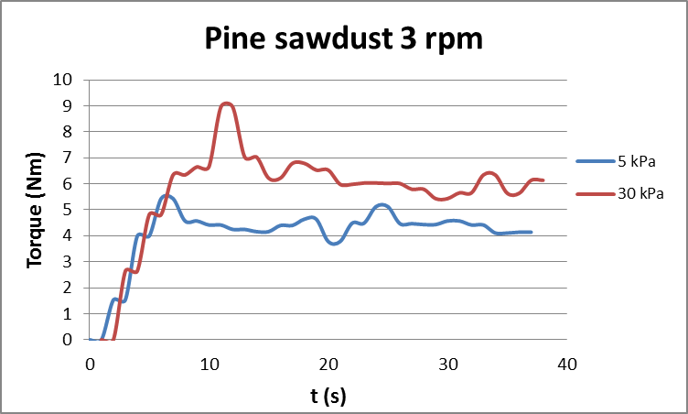
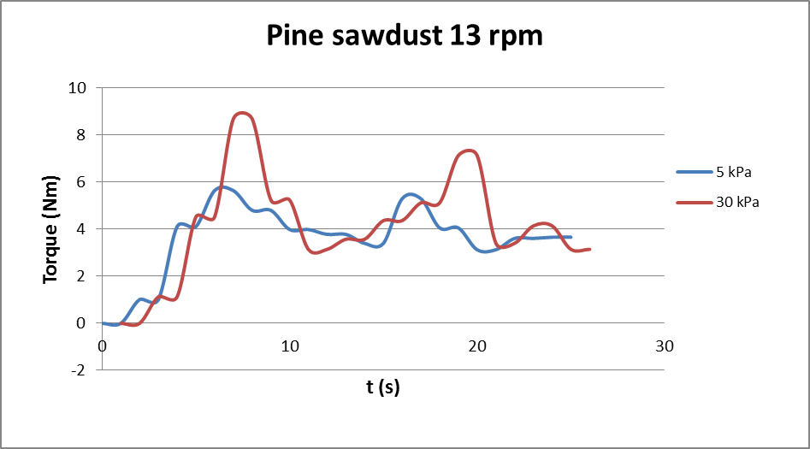
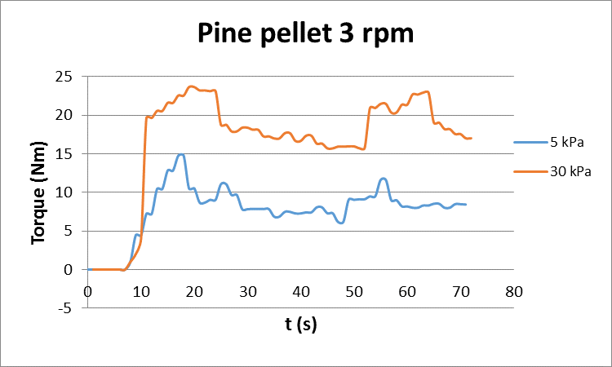
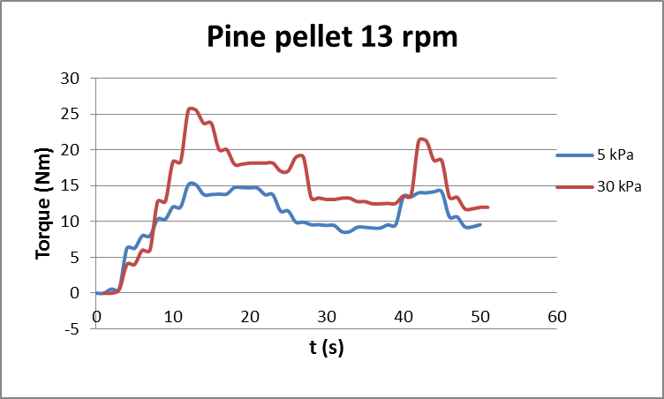
RESULTS
Typical torque-time curves obtained at normal pressures of 5 kPa and 30 kPa for rotational speed of 3 and 13 rpm obtained in vane shear tester.
XXV JKN „Postęp Naukowo-Techniczny i Organizacyjny w Rolnictwie”; Zakopane 2018

Slide 10
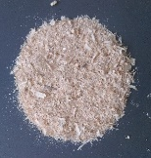
RESULTS
Mean values and 95% confidence intervals of torque for experimental materials in a range of moisture content, normal pressure and rotational speed.
XXV JKN „Postęp Naukowo-Techniczny i Organizacyjny w Rolnictwie”; Zakopane 2018

Slide 11
RESULTS
Table 2. Torque quotient factor
 | Rotational speed
Normal pressure | 3 rpm | 13 rpm
5 kPa | 2.17 | 2.40
30 kPa | 2.57 | 2.71
Table 3. Calculated shear strength τ obtained under different test conditions.
Test parameters | 5 kPa 10% m.c. | 5 kPa 4h compression 10% m.c. | 5 kPa 50% m.c. | 30 kPa 10% m.c. | 30 kPa 4h compression 10% m.c. | 30 kPa 50% m.c.
3 rpm | 3.15 ± 0.32 kPa | 6.76 ± 0.15 kPa | 8.12 ± 0.09 kPa | 8.12 ± 0.15 kPa | 20.75 ± 3.00 kPa | 17.14±1.56 kPa
13 rpm | 2.70 ± 0.25 kPa | 7.21 ± 0.25 kPa | 7.21 ± 0.11 kPa | 6.76 ± 0.28 kPa | 18.49 ± 2.50 kPa | 17.14 ±2.06 kPa
Table 4. Shear strength τ_{max} measured with Jenike shear tester.
 | Consolidation normal pressure and normal pressure during shearing kPa
Moisture content (%) | 15 7.5 | 15 15 | 30 15 | 30 30
10 | 7.02 ± 0.35 | 11.57 ± 0.26 | 12.06 ± 0.80 | 20.74 ± 0.36
20 | 7.40 ± 0.13 | 11.77 ± 0.64 | 12.36 ± 0.10 | 19.45 ± 0.52
30 | 7.45 ± 0.53 | 12.60 ± 0.11 | 13.14 ± 0.35 | 21.85 ± 1.04
40 | 7.66 ± 0.73 | 12.56 ± 0.84 | 13.33 ± 0.62 | 21.68 ± 0.60
50 | 7.29 ± 0.63 | 12.23 ± 1.31 | 13.66 ± 1.24 | 22.72 ± 1.82
XXV JKN „Postęp Naukowo-Techniczny i Organizacyjny w Rolnictwie”; Zakopane 2018

Slide 12
CONCLUSION
Values of torque, strength and flowability parameters of examined materials were influenced by kind of material, moisture content and consolidation stress. The value of measured torque was influenced by the kind of biomass and the consolidation pressure. No significant influence of rotation speed was observed on the value of maximum torque. Significant differences in values of maximum torque were found for different kinds of biomass. The equipment used could may also be useful in estimation of loads in screw conveyors used for transport of granular biomass.
XXV JKN „Postęp Naukowo-Techniczny i Organizacyjny w Rolnictwie”; Zakopane 2018

Slide 13
DZIĘKUJĘ!

